Slide 1


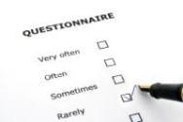
Six Sources of Bias or error – six simple things that can badly skew your results.
PROFESSIONAL DEVELOPMENT SERIES - 2011

Slide 2
Six Sources of Bias and error – six simple things that can badly skew your results.
The focus of this workshop is on the serious side effects stemming from simple aspects of questionnaire and analytical design.
For example the common practice of presenting respondents with big batteries of questions can lead not only to boredom and indifference, but also to serious skews.
And our analytical approach may also exaggerate our results as well. This workshop is a two-hour refresher course to help researchers stay on top of the game. It includes:
  Whose universe is it anyway? The effects of simple ‘screener’ questions.
  Question sequencing – how question order can markedly change results.
  The peril of big batteries.
  Framing effects. The effect of prompts and tone on the way people answer questions.
  You get what you test: the effects of assumptions and hypotheses on the data you get back.
  Analytical effects – how your choice of analysis may exaggerate your results.
Armed with this workshop, the professional researcher, and client, will be better aware of the common pitfalls that can secretly devalue your research.

Slide 3

DISCUSSION ONE
Sampling and design issues

Slide 4
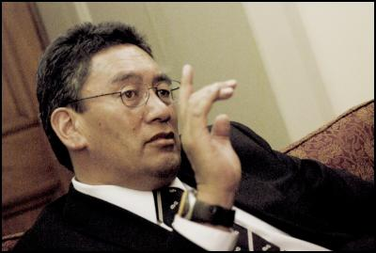
Hone questions Maori Party’s cosy relationship with National....

Slide 5
NZ Herald - Hone Harawira survey
Those who say the alliance with National has been bad for Maori people (37%) outnumber those who think it has been good for Maori (23%). The other 24% see some good and some bad in the coalition, and 16% are unsure or won't say.

Slide 6
NZ Herald - Hone Harawira survey
Those who say the alliance with National has been bad for Maori people (37%) outnumber those who think it has been good for Maori (23%). The other 24% see some good and some bad in the coalition, and 16% are unsure or won't say.
“The Weekend Herald went looking for voters on the Maori roll up and down the Te Tai Tokerau electorate, which extends from Cape Reinga down to the Auckland Harbour Bridge and into West Auckland to the eastern edge of the Waikumete Cemetery.” N=70
The question is – in other electorates does the percentage who see the Maori Party/National party alliance as “bad” differ from the figure here in Hone’s electorate. Has Hone stirred up any particular feeling in his electorate??

Slide 7
  Whose universe is it anyway? The effects of sampling and simple ‘screener’ questions.
When we conduct a survey we make some huge decisions to begin with:
Sample size. How many people will we listen to?
Who is our sample universe?
Very often we are required to zoom-in on a sample universe that is quite tight, and, scientifically, we lose something along the way.
All adults 18+
Or all those young males who drink alcohol
Those who drink Brand X weekly?
Or all young males all those who drank beer or spirits weekly?
All male adults 18-39

Slide 8
Why do we zoom in? What do we gain, and what do we lose?
What we lose:
A reference point. We don’t know how our target differs from others. We don’t know how much of the story is explained by their tastes or by their cohort.
What we gain:
Specificity. We’re talking to the core market.

Slide 9
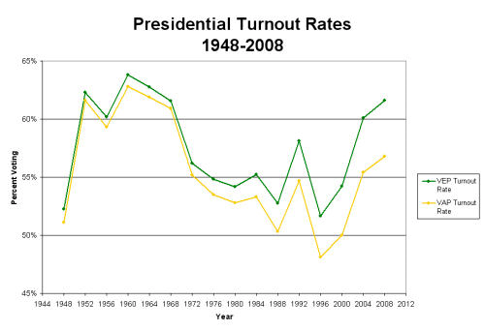
  Whose universe is it anyway? US Political Polling
As we drill down, our sampling becomes more problematic and our assumptions start becoming more risky. How do we know what the likelihood of voting will be?
All adults 18+
All likely voters?
All likely voters in swing states?
All registered voters?
All eligible voters?

Slide 10
Getting the sampling right.
Get a sample that’s big enough to work with.
  Not just overall sample size
  But size of sub-sample.
Set quotas that reflect the sample universe.
Specify number of call-backs in order to reach a fair sample of hard to reach people.
Don’t over-rely on assumptions.
Don’t drill down too tight. Seek an element of comparability.

Slide 11

Checklist for professionals
CHECKLIST
Spend extra time getting your sampling sorted out.
  Sample size (main sample and sub-groups)
  Quotas to reflect the ‘universe’
Efficiency is good (do you really wish to listen to people who don’t receive the product or service being tested?) but don’t lose your reference point. Good science always has a ‘control.’
Are we hearing all stakeholders?

Slide 12
DISCUSSION TWO
Question sequencing and context

Slide 13
Directional context effects. An experiment in 1950 and 1983.The communist and reporter questions.
Should the United States let Communist newspaper reporters come in here and send back to their countries news as they see it?
Should a communist country like Russia let American newspaper reporters in and send back news as they see it?

Slide 14
Directional context effects. An experiment in 1950 and 1983. The communist and reporter questions.
1950
1950
Should the United States let Communist newspaper reporters come in here and send back to their countries news as they see it?
Should a communist country like Russia let American newspaper reporters in and send back news as they see it?
36%
When asked first
73%
When asked second

Slide 15
Directional context effects. An experiment in 1950 and 1983. The communist and reporter questions.
1983
1983
Should the United States let Communist newspaper reporters come in here and send back to their countries news as they see it?
Should a communist country like Russia let American newspaper reporters in and send back news as they see it?
55%
When asked first
75%
When asked second

Slide 16
Types of contextual effect
Retrieval effects. (Different answers if you come in cold versus easing your way into the subject.)
Correlation context effects on judgement
  Assimilation effects – context drives up support for a position. (Such as the communist reporter questions. )
  Contrast effects – when general questions follow specific questions. (How happy is your marriage? How happy are you in life generally?)

Slide 17
Do you favour or oppose the passage of the Monetary Control Bill?
Preceding block of questions
Do you favour or oppose the passage of the Monetary Control Bill?
OPPOSE
FAVOUR
DON’T KNOW
NEUTRAL QUESTIONS FIRST
25%
13%
63%
SCATTERED INFLATION QUESTIONS FIRST
20%
9%
71%
BLOCK OF INFLATION QUESTION FIRST
18%
28%
55%

Slide 18
Checklist for professionals
CHECKLIST
Just generally, try an ease respondents into a topic – give them a moment to get into survey mode, and to retrieve the subject matter cognitively. A good role for the intro-text.
Try to design questionnaires that go from general to specific – from macro to micro.
Test or allow for order effects.
Sometimes there’s no way around it – you end up with a reporter/communist moment and neither question “belongs” in front. Then one solution is to reword both questions – “some people say this, others say that...what do you feel about letting reporters in?”

Slide 19

DISCUSSION THREE
  Framing effects – at a more micro level within the question.

Slide 20
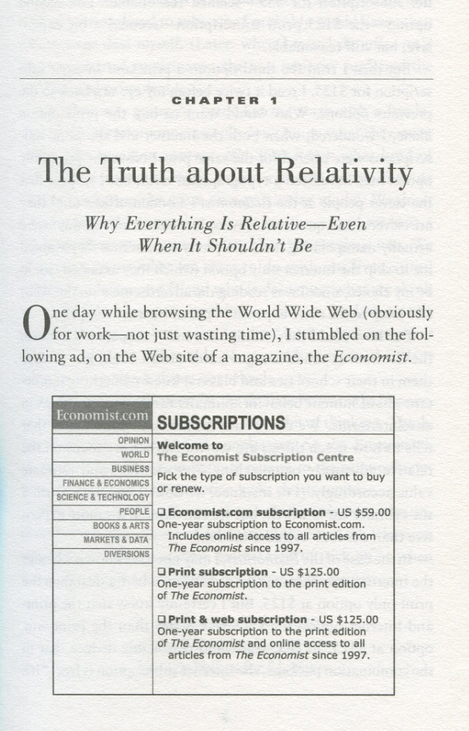
  Framing effects. The effect of prompts and tone on the way people answer questions.
Framing is dictated by choices.
Here’s an example from Don Ariely.

Slide 21
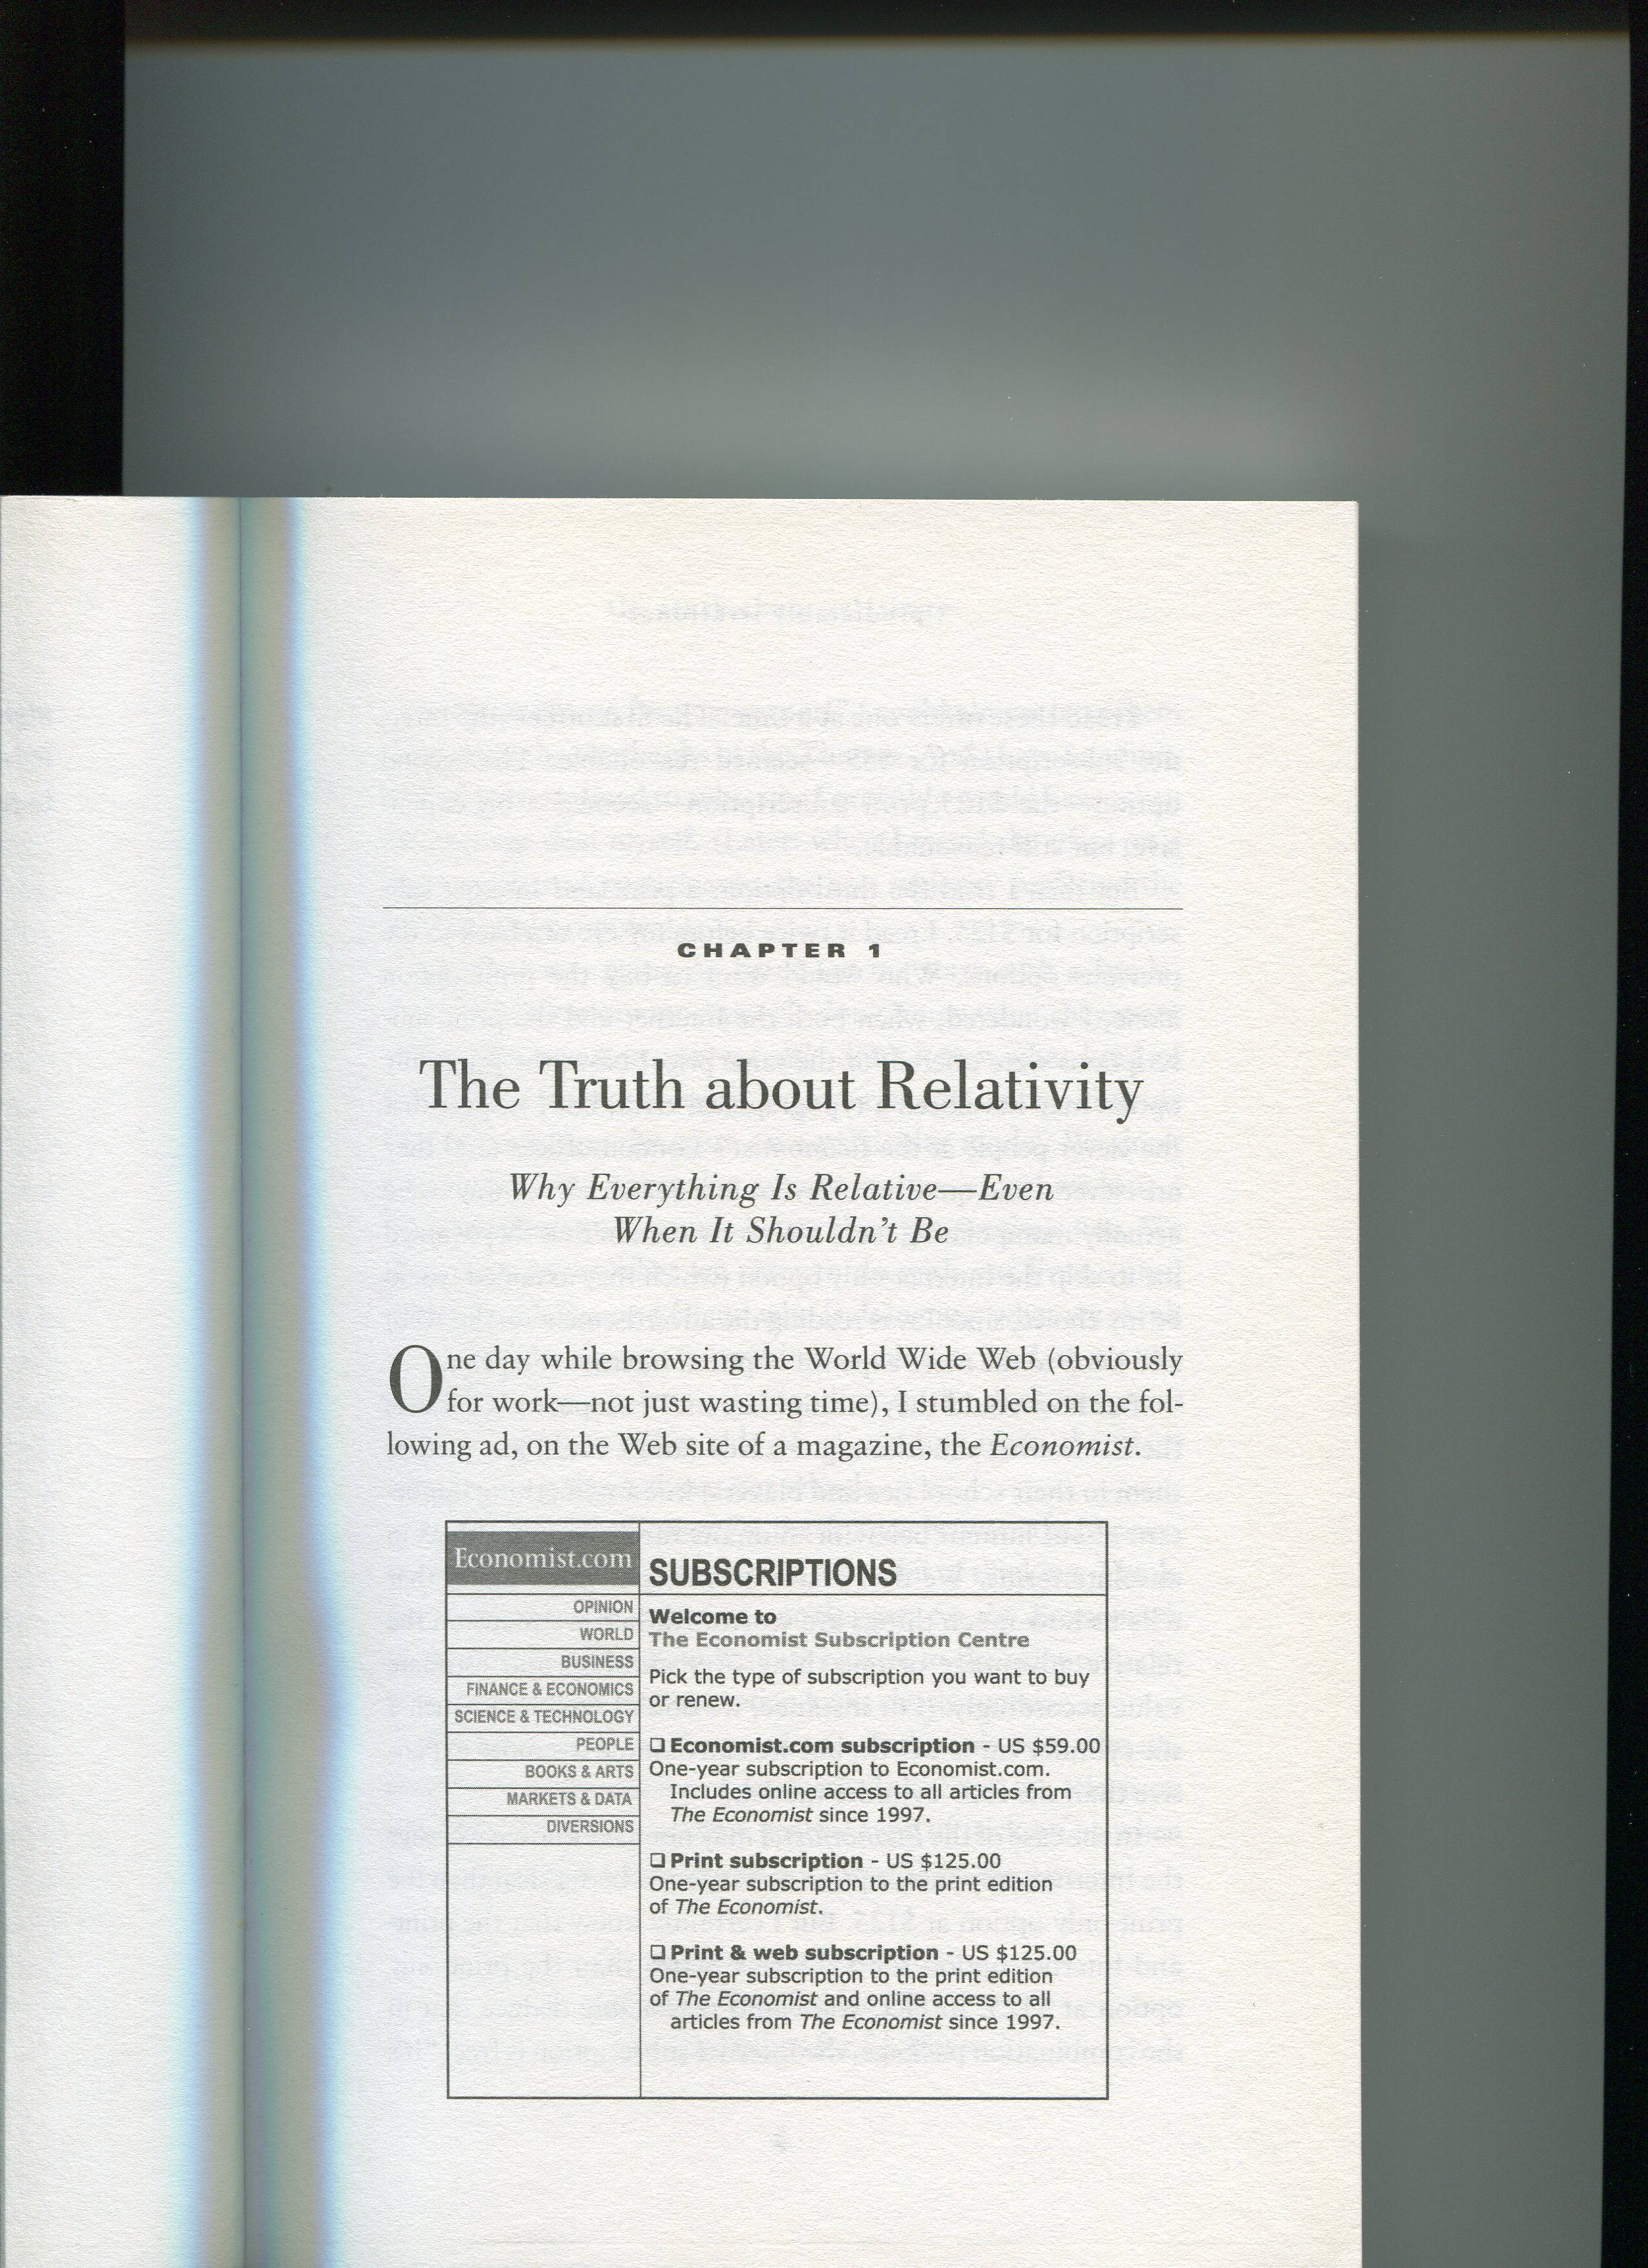
Which one would you pick?
☑


16%

☑

0%


☑
84%

Slide 22
Which one would you pick?
TWO CHOICES – THE DECOY IS REMOVED


☑
16%
68%
☑


84%
32%

Slide 23

What just happened?
The three choices were about two things.
Delivery medium (web versus hard copy.)
The price $59 versus $125.)
The unintentional (or very intentional) effect of having the unpopular middle choice was to frame the options mostly in terms of delivery media. Hey – two media for the price of one!
The simpler choice framed it in terms of cost. Why pay more than $59?
The issue is one of framing.

Slide 24
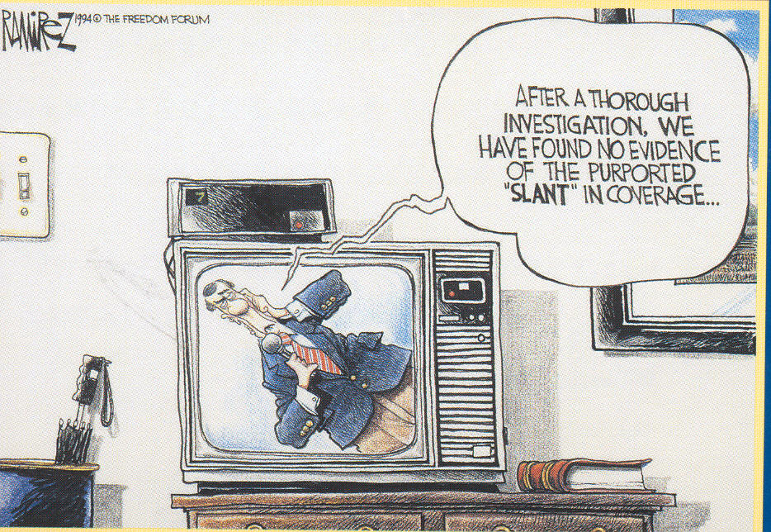
Response order effects
Primacy and recency – can effect the way we deal with and retrieve our thoughts.
Primacy effects occur more in written surveys. First mentioned gets more votes.
Recency effects occur more often in phone surveys. Last mentioned gets more votes.

Slide 25
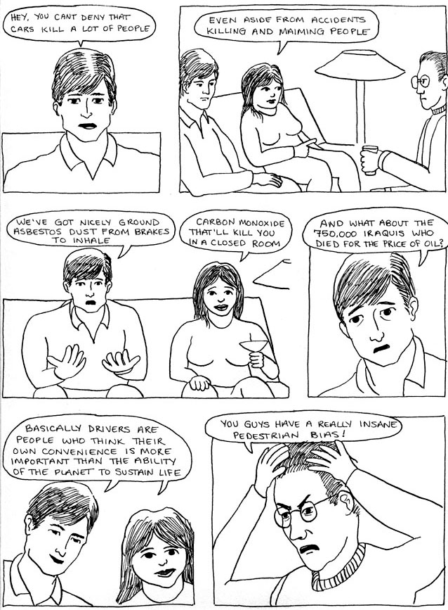
Acquiescence Bias
A tendency to agree with unbalanced statements.
The satisficing theory suggests that respondents tend to assume that the main option on offer is probably the “correct” option. The easiest response is simply to “agree.”

Slide 26
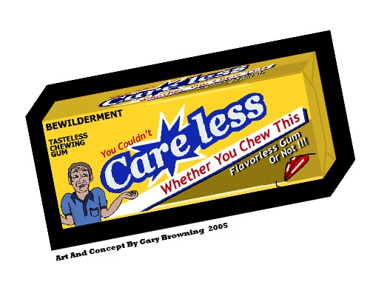
The presence of a “No Opinion” filter.
Traditionally we’re trained to include “No Opinion” as an option.
Findings suggest that most people who offer “no opinion” do have an opinion. By removing the option you encourage a more thoughtful answer.
A matter of judgement.

Slide 27

"Which parent should have custody of the child?"
Parent A is moderately suitable to be the guardian in multiple ways.
Parent B has a close relationship with the child but a job that would take him or her away for long periods.

Slide 28
"Which parent should be denied custody of the child?"
Parent A is moderately suitable to be the guardian in multiple ways.
Parent B has a close relationship with the child but a job that would take him or her away for long periods.

Slide 29
Even a small change in the wording of a question can affect how people search through available information, and hence the conclusions they reach. This was shown using a fictional child custody case.^{[14]} Subjects read that Parent A was moderately suitable to be the guardian in multiple ways. Parent B had a mix of salient positive and negative qualities: a close relationship with the child but a job that would take him or her away for long periods. When asked, "Which parent should have custody of the child?" the subjects looked for positive attributes and a majority chose Parent B. However, when the question was, "Which parent should be denied custody of the child?" they looked for negative attributes, but again a majority answered Parent B, implying that Parent A should have custody.^{[14]}

Slide 30
Checklist for professionals
CHECKLIST
Think “Economist Example” where framing shifted respondents from one dimension (delivery medium) to another (price) simply through the answer options.
Think carefully about “no opinion” – if possible, work the respondent a little harder to deliver an opinion. Don’t let it become the lazy or satisficing option.
Ensure questions are neutrally worded – and that answer options are consistently framed.

Slide 31
DISCUSSION FOUR
Big batteries

Slide 32
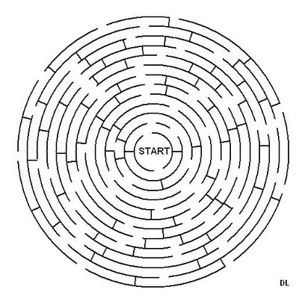
Avoid huge batteries.
Tiresome to fill in.
They drive respondents to use a satisficing heuristic which goes like this:
  Read the top question. Answer it as well as you can.
  Do the same for the second question. Get the gist?
  Then skim the other questions and anchor your answer around about the same result as your top two.
Anchoring effect: your answer for the first question influences your answers for the rest of the battery.

Slide 33
Thinking back to your experience with Shop X, please indicate your degree of agreement with the following statements. | Strongly agree | Agree | Neutral | Somewhat disagree | Disagree | Strongly disagree | Not sure
I prefer making a purchase from Shop X to using local offices, malls or stores. | Ο | Ο | Ο | Ο | Ο | Ο | Ο
I prefer Shop X over other home shopping services (i.e., catalogs, "1-800" services or television). | Ο | Ο | Ο | Ο | Ο | Ο | Ο
Shop X doesn't just sell products or services--it entertains me. | Ο | Ο | Ο | Ο | Ο | Ο | Ο
I received special rewards and discounts from doing business with Shop X | Ο | Ο | Ο | Ο | Ο | Ο | Ο
I say positive things about Shop X to other people. | Ο | Ο | Ο | Ο | Ο | Ο | Ο
I consider Shop X to be my first choice when I need products or services of this type. | Ο | Ο | Ο | Ο | Ο | Ο | Ο
The "look" of the Shop X web site is appealing to me. | Ο | Ο | Ο | Ο | Ο | Ο | Ο
I really like doing business with Shop X | Ο | Ο | Ο | Ο | Ο | Ο | Ο
I intend to continue to visit the Shop X site in the future. | Ο | Ο | Ο | Ο | Ο | Ο | Ο
I intend to purchase from Shop X in the future. | Ο | Ο | Ο | Ο | Ο | Ο | Ο
Shop X is one of the first places I intend to look when I need the type of merchandise or services it provides. | Ο | Ο | Ο | Ο | Ο | Ο | Ο
It would require a lot of time and effort on my part, to set up an account with another shop . | Ο | Ο | Ο | Ο | Ο | Ο | Ο
It would take a lot of time and energy to look for another retailer for this type of product. | Ο | Ο | Ο | Ο | Ο | Ο | Ο
The products and/or services I purchased from Shop X were a good value. | Ο | Ο | Ο | Ο | Ο | Ο | Ο

Slide 34






















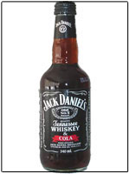
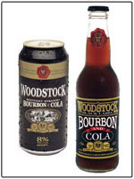

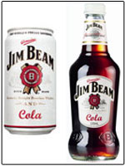
THIS DRAG AND DROP EXERCISE IS MORE INTUITIVE – AND ACTUALLY HANDLES MORE DATA THAN THE PREVIOUS PAGE.
Here’s a sorting exercise: which words go with which brand?
Simply drag the words into the appropriate bucket below.
NONE OF THESE BRANDS

Slide 35
Checklist for professionals
CHECKLIST
Avoid big batteries. The are cognitively tedious, lead to “lazy answering.”
Less questions perhaps? Perhaps you need to run some qualitative research first to refine your search.
Break batteries up – try for a maximum of 8 rows or less.
Try alternatives that are more engaging.

Slide 36
DISCUSSION FIVE
  You get what you test: the effects of assumptions and hypotheses on the data you get back.

Slide 37
  You get what you test: the effects of assumptions and hypotheses on the data you get back.
We need to be very careful about the assumptions we make, and the conclusions we reach.
To illustrate – let’s look briefly at two case studies.
  Aluminium.
  Breakfast.

Slide 38
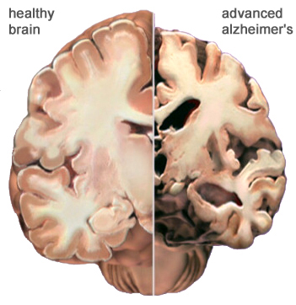
Evidence linking aluminium and Alzheimer's disease?
The hypothesis that there is a link between aluminium and Alzheimer's disease was first put forward in the 1960s (Terry and Pena 1965, Klatzo et al 1965). Since then, researchers have claimed a number of other circumstantial links between aluminium and Alzheimer's disease.
Aluminium has been shown to be associated both with plaques and with tangles in the brains of people with Alzheimer's disease (Crapper et al 1976).
However, the presence of aluminium does not mean that the aluminium was the causal factor − it is more likely to be a harmless secondary association.
Some have claimed that people with Alzheimer's disease have a higher than average level of aluminium in their brains. However, other studies find no difference between the overall amount of aluminium in the brains of people with Alzheimer's and the amount in normal brains (Trapp et al 1978).

Slide 39
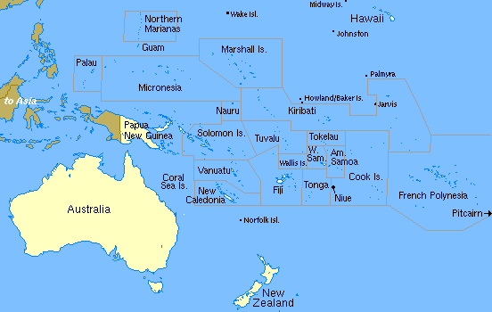


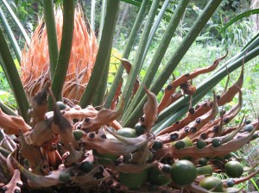
One example of research that proved the link.
Guam Island
Positive testing for aluminium
Chamorro People
Cycad Plant

Slide 40

Kellogg survey in Australia, 2008
Teachers Rate Breakfast Cereal Top of the Class Australian parents urged to serve healthy fibre this term
Attentiveness in the classroom can be a key indicator that a child has had breakfast, according to the results of a recent survey of 1,000 Australian primary and secondary school teachers. In contrast, tiredness and lack of concentration are tell-tale signs that a child has skipped breakfast.
The nationwide survey was commissioned by Kellogg Australia to determine whether teachers’ experience in the classroom is consistent with the current research linking breakfast eaters with better concentration at school.
If the experience of Australian teachers is anything to go by, the research is right on the mark.
The findings revealed:
  96% of teachers say students who eat breakfast pay more attention;
  88% of teachers say that students who eat breakfast perform better at school;
  79% of teachers say that students who eat breakfast are more interested in learning than those who don’t.
  When asked to nominate their choice of the best breakfast options for students, teachers nominated breakfast cereals as the most popular option.
Release Date : 09-09-2008
Teachers Rate Breakfast Cereal Top of the Class

Slide 41
Anyone have a problem with this?
Kids who have breakfast perform better at school
Kids who eat breakfast are more interested in learning.
Cereal is the most popular form of breakfast.
Hence – kids who eat Kellogg’s do better at school.

Slide 42
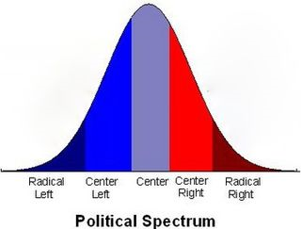
So two common problems.
Reinforcing common beliefs
Clients seek to ‘prove a point.’
Examples include much discussion about so-called generations x and y.
Or assumptions about “left and right” in political surveys. (Apparently still the prevailing paradigm?)
Being commissioned by FMCG to help a marketing message.
Being commissioned by a lobby group to test opinions.
Being commissioned by a Government Department that wants to listen – but does not want to be criticised.

Slide 43
Checklist for professionals
CHECKLIST
Be careful of conventional wisdom. It just may be wrong.
Be careful of clients who want to “prove a point” – be extra rigorous because it’s your research that will get questioned.
Don’t just prove something is true –test whether the opposite is false as well.

Slide 44
DISCUSSION SIX
We’re here to make up the numbers. Analytical effects.

Slide 45
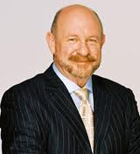
Analytical effects – how your choice of analysis may exaggerate your results.
Logical errors. Often to do with causality.
TV One viewers are older – therefore, TV One makes people age rapidly. (Actually, I think it does.)

Slide 46
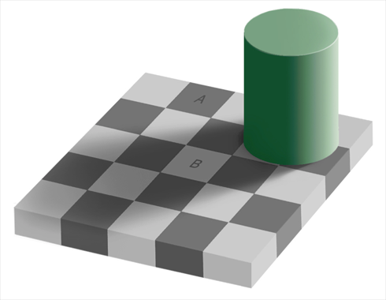
Analytical effects – how your choice of analysis may exaggerate your results.
Mean scores without statistical testing.
We run the risk of inferring differences when these nuances are not significant.
The grey square optical illusion.

Slide 47
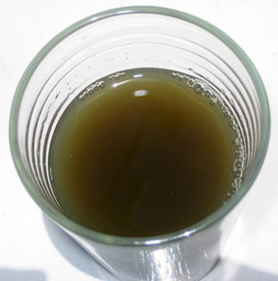
Analytical effects – how your choice of analysis may exaggerate your results.
Segmentation techniques have the effect of categorising what often begins as mushy data.
We’re forcing shades of grey to masquerade as black and white.
We then exaggerate this effect by applying pithy labels that further over-simplify the differences.
One can segment the contents of this glass into three distinct categories!

Slide 48
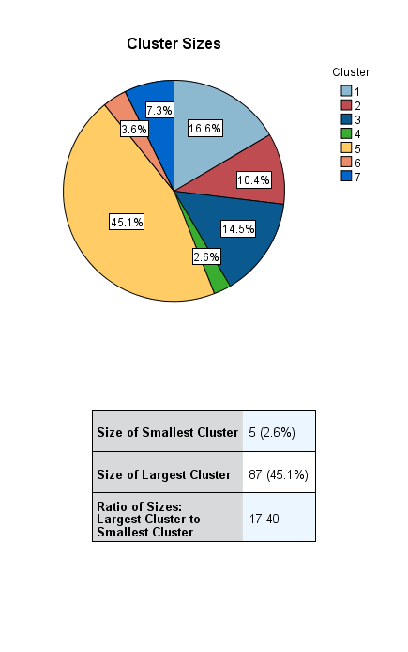
273 PEOPLE ANSWERED FOUR QUESTIONS WE USED FOR A SEGMENTATION/CLUSTER ANALYSIS. Which solution is best?
K-means cluster for 3, 4, 5 or 7?
2 step cluster?

Slide 49


Slide 50
Analytical effects – how your choice of analysis may exaggerate your results.
Often we have a drive to “find something” when there may be very little going on in the data (either because the questions were not discriminating, or the subject just isn’t passionate.)
Perhaps the answer is – there IS no answer.
Then we run the risk of Confirmation bias.
Do we see what we choose to see?

Slide 51
We may be biased without realising it! Here are six reasons for bias.
Biased search for information
Preference for early information
Persistence of discredited beliefs
Biased memory – or recency effects
Biased analytical style – for example testing for positive relationships, but not testing for negative relationships.
Biased interpretation – including illusions
Are arthritis symptoms more likely on rainy days?
Days | Rain | No rain
Arthritis | 14 | 6
No arthritis | 7 | 2

Slide 52

Julius Richard Petri (invents dish around 1870)
Allows us to compare outcomes in identical conditions with just one variation.
The heart of good science.

Slide 53
Checklist for professionals
CHECKLIST
Always run a parallel Petri dish – compare and contrast.
Challenge your own self. Set out to prove yourself and your assumptions wrong.
Be careful of over-simplifying or over-dramatising differences that might be slight.

Slide 54
SUMMING UP
Is there an overall theme here?.

Slide 55
Checklist for professionals
SUMMING UP
Research work is riddled with professional judgements. We deal in shades of grey – and whatever we do, we’re setting up an artificial situation (a survey, a phone call) and asking an often unwilling respondent to fairly share their opinion.
We’re usually asking them to convert that opinion into a number – so something gets lost in translation.
Then we convert it back – and though we try to be scientifically rigorous, we are also human. We see things we’re wishing to see.
Being aware of the fuzzy edges is a start. An underlying scientific rigour is essential – so is humility and fear. A desire to prove ourselves wrong combined with a fear of being found wrong!

Slide 56

Thank you!
Duncan Stuart FMRSNZ
duncan@kudos-dynamics.com
Telephone 64 9 366 0620
www.kudos-dynamics.com
Funds from all our projects go directly to the language school we built and support in Siem Reap Cambodia. www.savong.com

